Slide 1
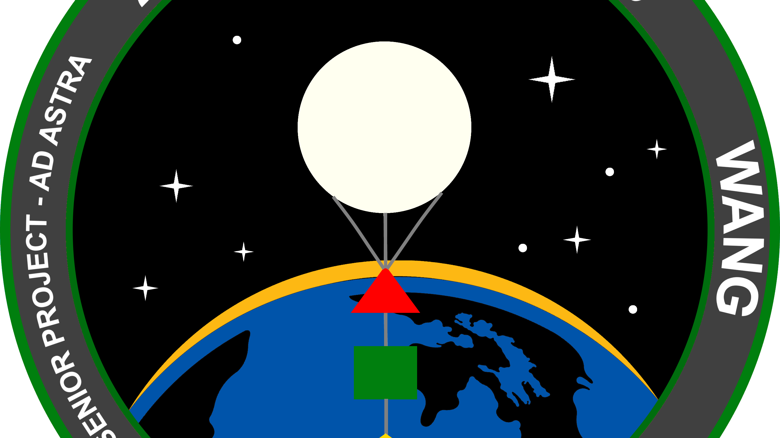
ASTRAIOS - Above and Beyond Into Near Space
Ian Wang

Slide 2
ProJect Achievement
Seniors will identify meaningful, project-specific benchmarks and demonstrate the degree to which they have attained them. These measurable benchmarks articulate what seniors specifically wish to accomplish in their field of inquiry.

Slide 3


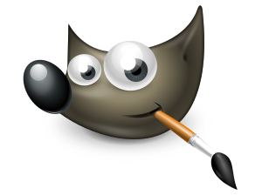
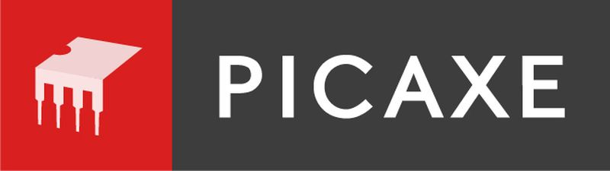
Project Achievement Goal
I will create a video lesson explaining the different components of the Tyee Flight Controller. I will also be CADing, programming my own satellite, as well as creating a mission patch. My mentor is James Burke who works at Tyee Middle School as a STEM & CTE teacher. By creating a video lesson explaining the Tyee Flight Controller, I hope to help students understand the components of their satellite better. I also hope to provide an additional resource for my mentor to use in his Flight and Space curriculum at Tyee. My portfolio will showcase my video lesson, mission patch design, as well as my satellite model.

Slide 4
Context
What made you choose this topic?
I chose this topic because I wanted to put the skills which I learned in robotic and my AP CS class to use.
Explain your motivation for choosing this project.
My motivation for choosing this project is to learn more about near space satellites, as well as to educate students.
Did you have any previous experience with the topic?
I do have previous experience. In middle school I was involved in the Tyee Satellite Club Program.
What were you hoping to accomplish?
I was hoping to create my own CAD model, mission logo, as well as create a video lesson for students to use to better understand the flight controller.

Slide 5
Introduction to Process
What was your initial plan?
My initial plan for this project was to create my own cube-sat, create a handbook for students, and to launch the cube-sat along with the students at Tyee.
How did you originally plan to move forward towards completing your project?
I originally planned to move forwards to complete my project by helping with the Flight and Space classes at Tyee. In that time I also planned to provide build my satellite with the students.

Slide 6
Learning stretch
Seniors will design and maintain an intellectually challenging project that employs skills and knowledge developed over the course of their education. Students will push themselves beyond their comfort zone, extend their learning, maximize the project’s impact, and move beyond the I.S. community.

Slide 7
Learning Stretch Goal
I chose this topic because I am interested in space as well as near-space satellites. As part of this project, I will need to learn how to program a micro controller in VBA, edit a video, CAD, graphic design, as well as read a schematic. I’d be learning these skills through the consultation of online resources, as well my mentor and experts in the field. I will showcase my goal by showing my video lesson, CAD model, code, as well as skills which I have acquired as part of my project. My success will be demonstrated through the survey data from the viewers of my video.

Slide 8
Context
What did you hope to learn?
I had a little bit of experience going into the project with CAD, video editing, as well as graphic design. However I wanted to show a more depth understanding of these skills.
What did you need to learn?
I needed to learn how to program in BASIC (VBA)
What was most enjoyable, or fun to learn?
I would say that I had the most fun CADing a mockup of my satellite.
How will you demonstrate what you’ve learned?
I will demonstrate what I’ve through showcasing my CAD mockup, patch design, as well as video lesson which I made.
I needed to learn how to use GIMP
I needed to learn how to add effects for video editing
I also had a great time designing the mission patch.

Slide 9
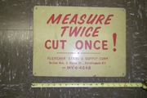
Successes/Areas of Growth I
Constraints and Criteria are important in any project.
Research thoroughly before design.
“Measure Twice Cut Once”
Don’t be afraid to not know the answer to something
I could’ve done a better job seeking out people knowledgeable in the field
Overall successful in terms of finished product.
Notes:
My goal was to design a CAD mockup of the satellite that I was going to build. Going into the process I had some experience using Autodesk inventor in robotics. The main component was choosing a design which would be optimal in the constraints for the satellite. (500grams, 6”x6”x6”). Prior to designing the satellite, I did extensive research to determine what shape I wanted. Throughout the process of making my satellite I encountered some roadblocks such as trying to figure out what constraint to use or ensuring that my measurements were correct in order to achieve the correct geometry. This experience helped me get much more familiar with inventor and discover new tools and features within the application.

Slide 10
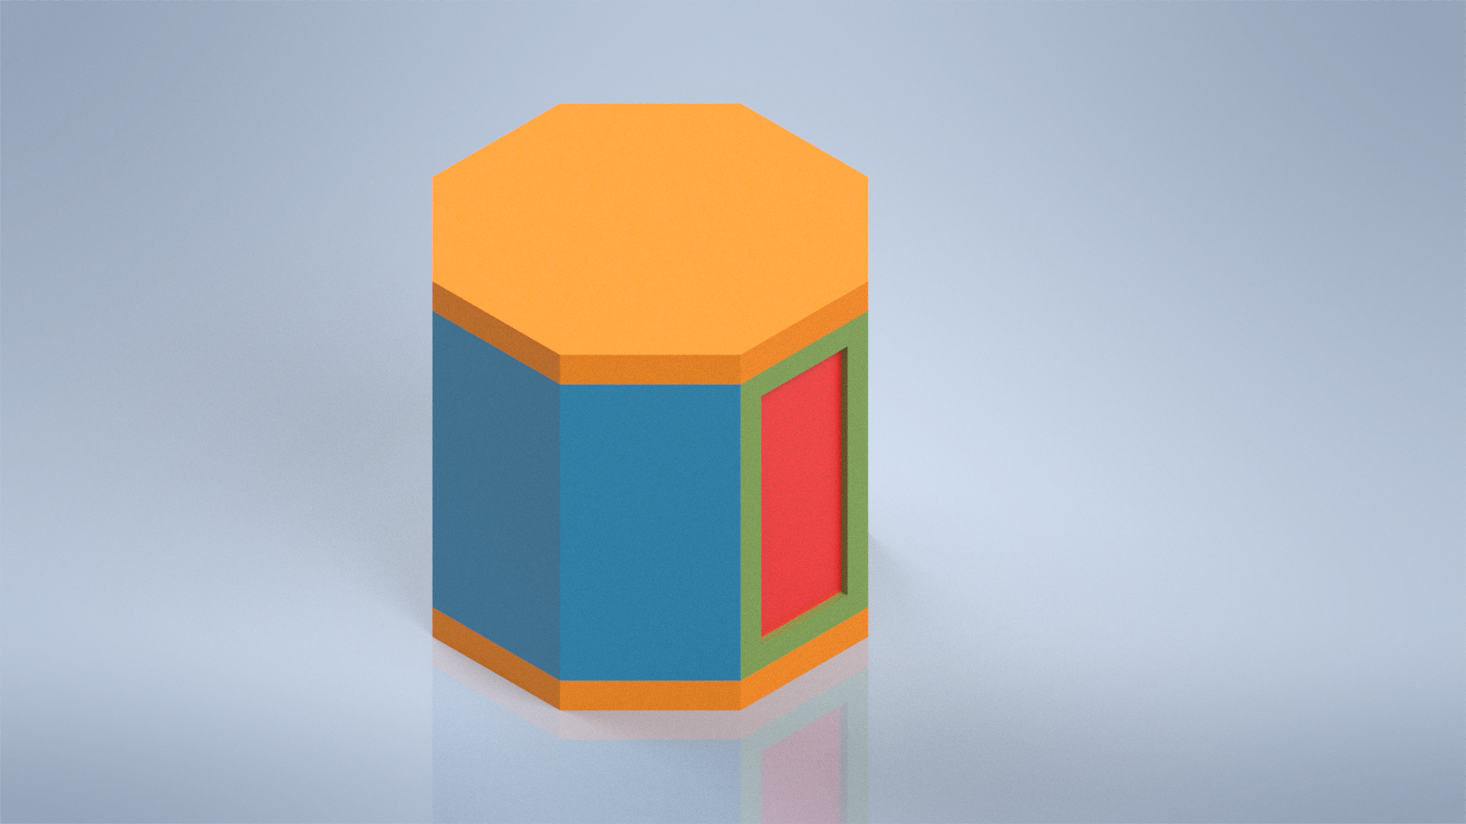
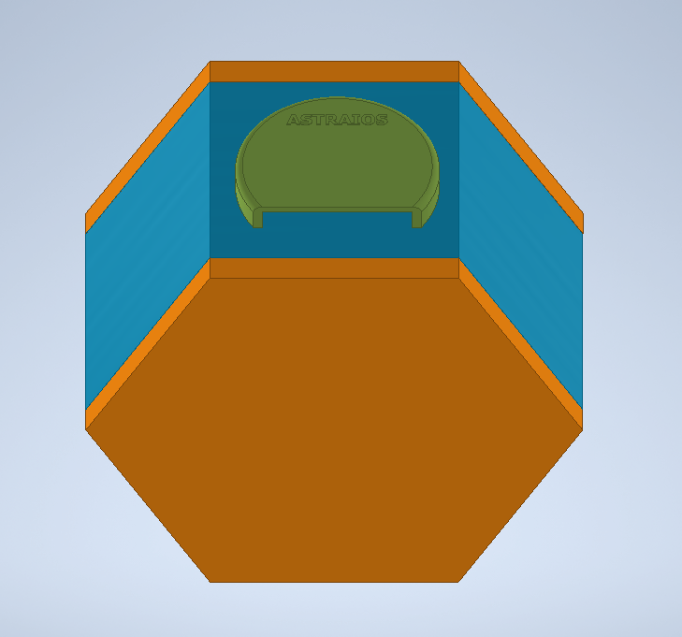
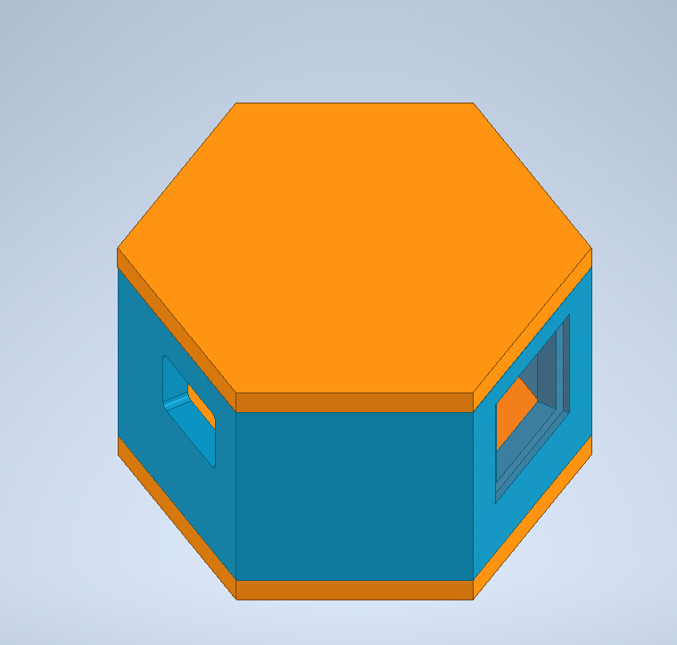
Deliverable 1
Iteration 1 of my satellite
Iteration II of my satellite

Slide 11
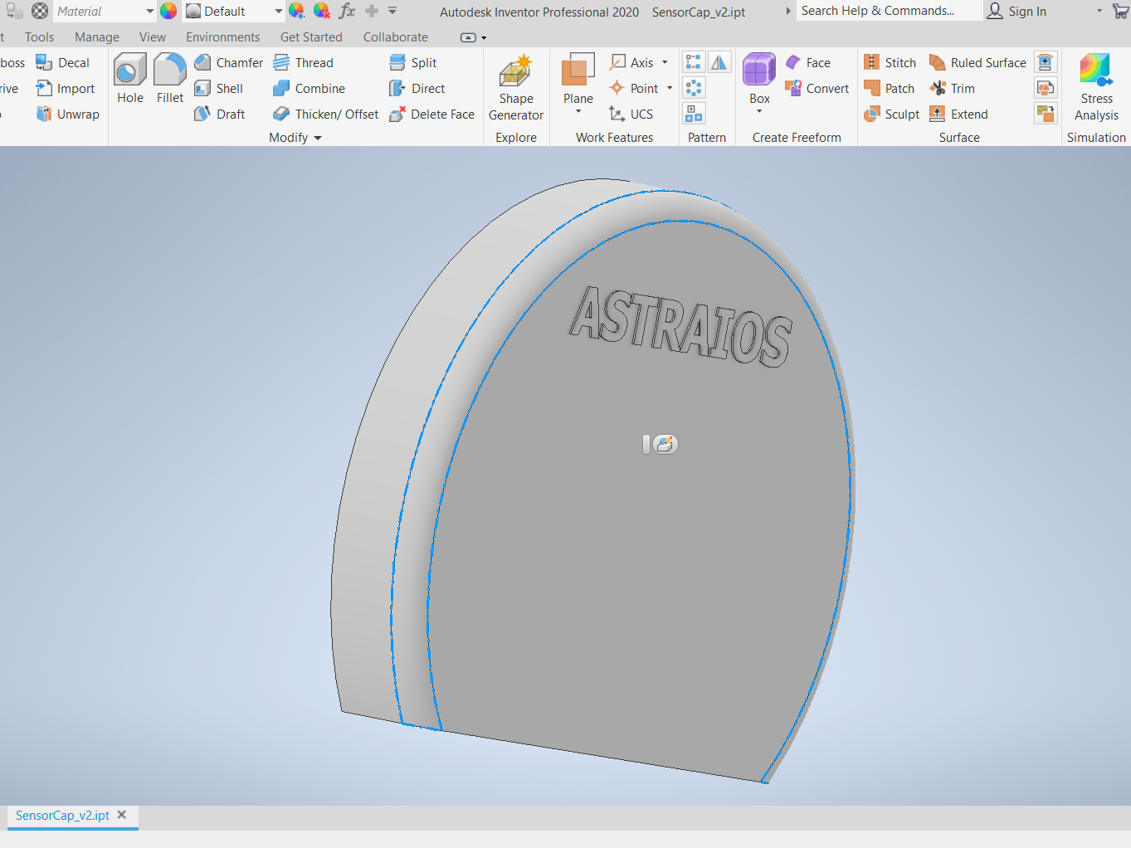
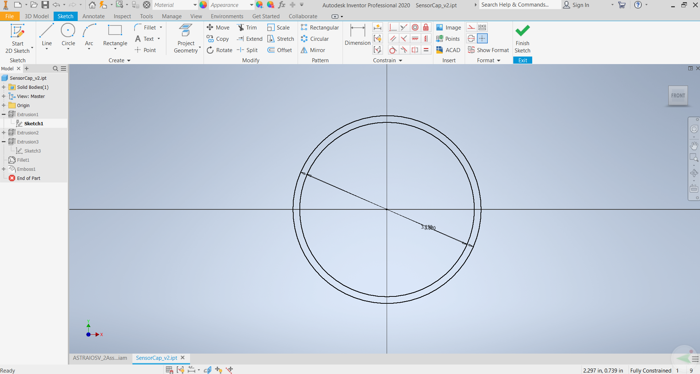
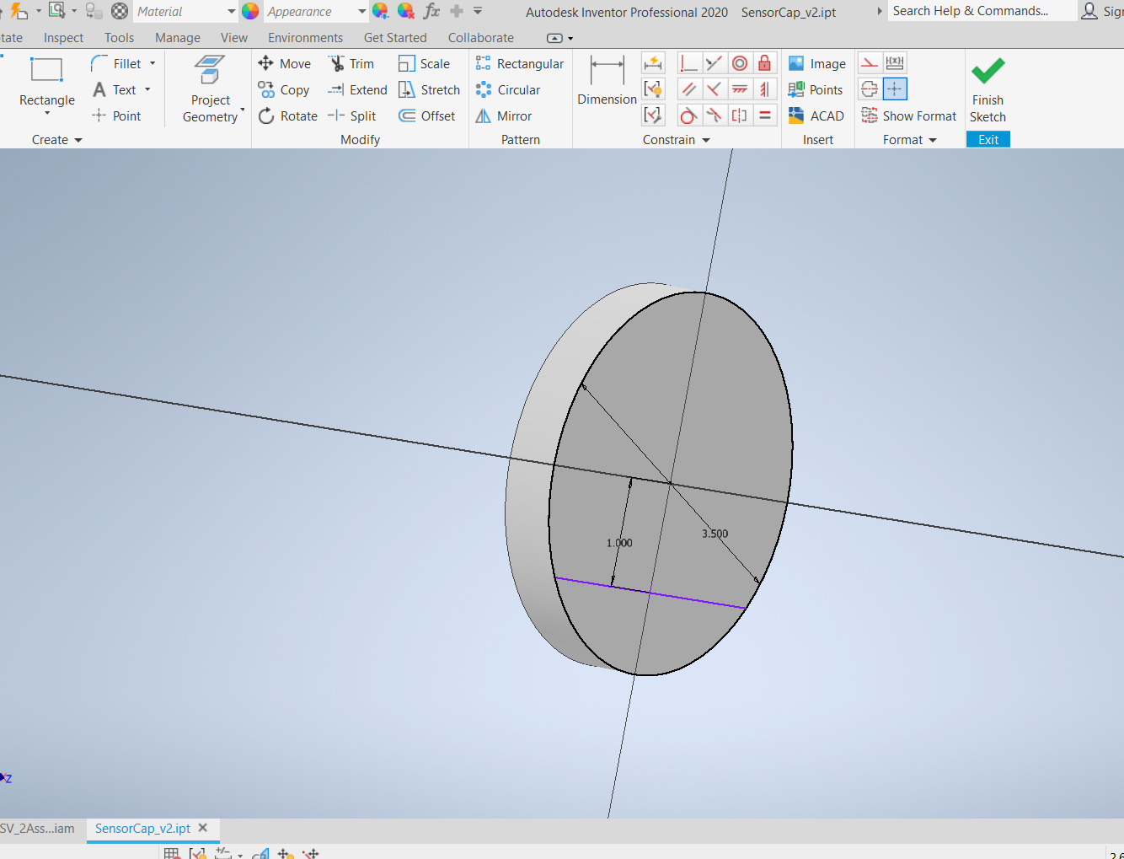
Sensor Cap Designing Process

Slide 12
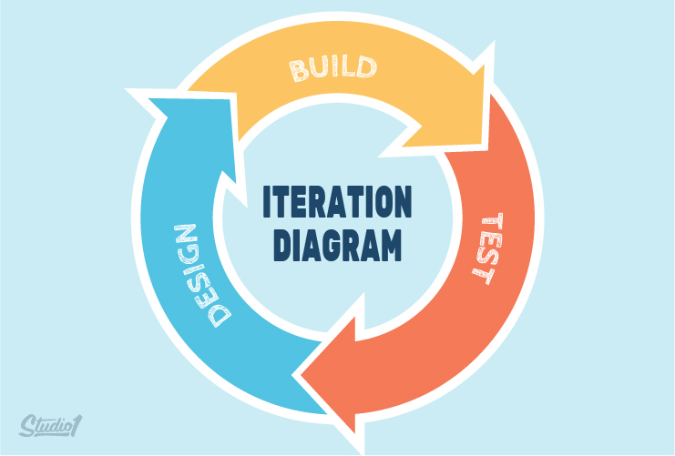
Successes/Areas of Growth II
Designing the mission patch was fun and enjoyable
Using someone else’s work as inspiration and basis for yours is okay
Iterations & Brainstorming is important
Take many different samples and cross examine
I could make it look better by adding more creative elements.
Notes:
My goal was to design a CAD mockup of the satellite that I was going to build. Going into the process I had some experience using Autodesk inventor in robotics. The main component was choosing a design which would be optimal in the constraints for the satellite. (500grams, 6”x6”x6”). Prior to designing the satellite, I did extensive research to determine what shape I wanted. Throughout the process of making my satellite I encountered some roadblocks such as trying to figure out what constraint to use or ensuring that my measurements were correct in order to achieve the correct geometry. This experience helped me get much more familiar with inventor and discover new tools and features within the application.

Slide 13

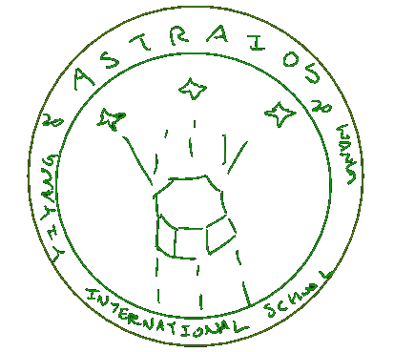
Deliverable 2
Original Inspiration
Draft Sketch

Slide 14
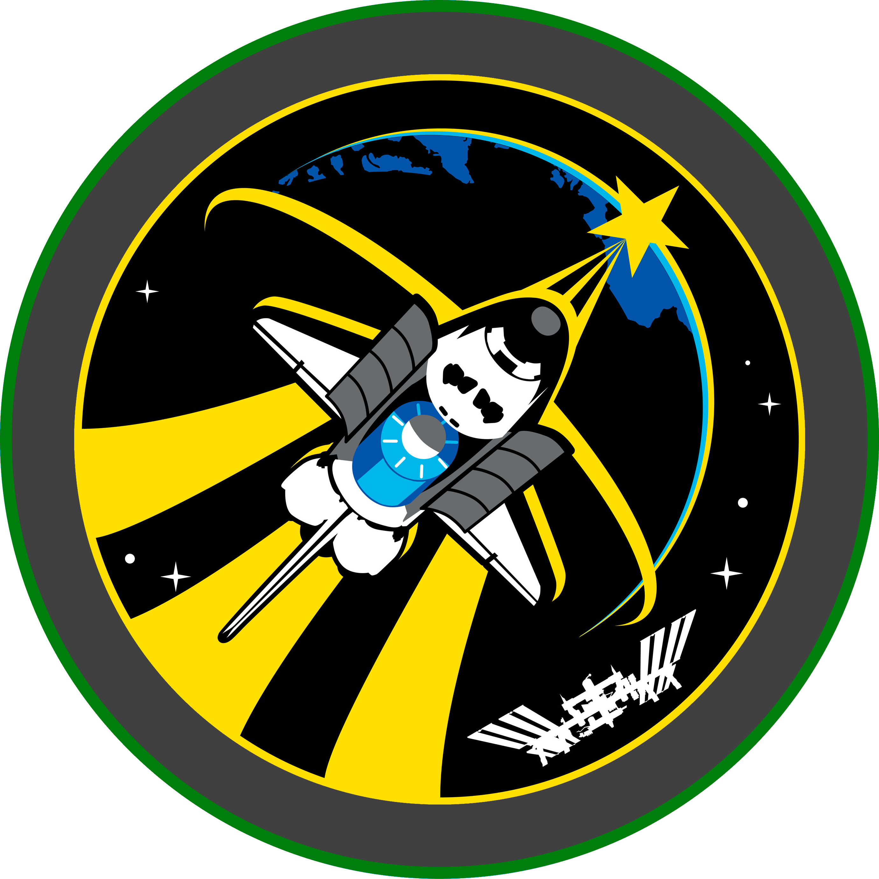
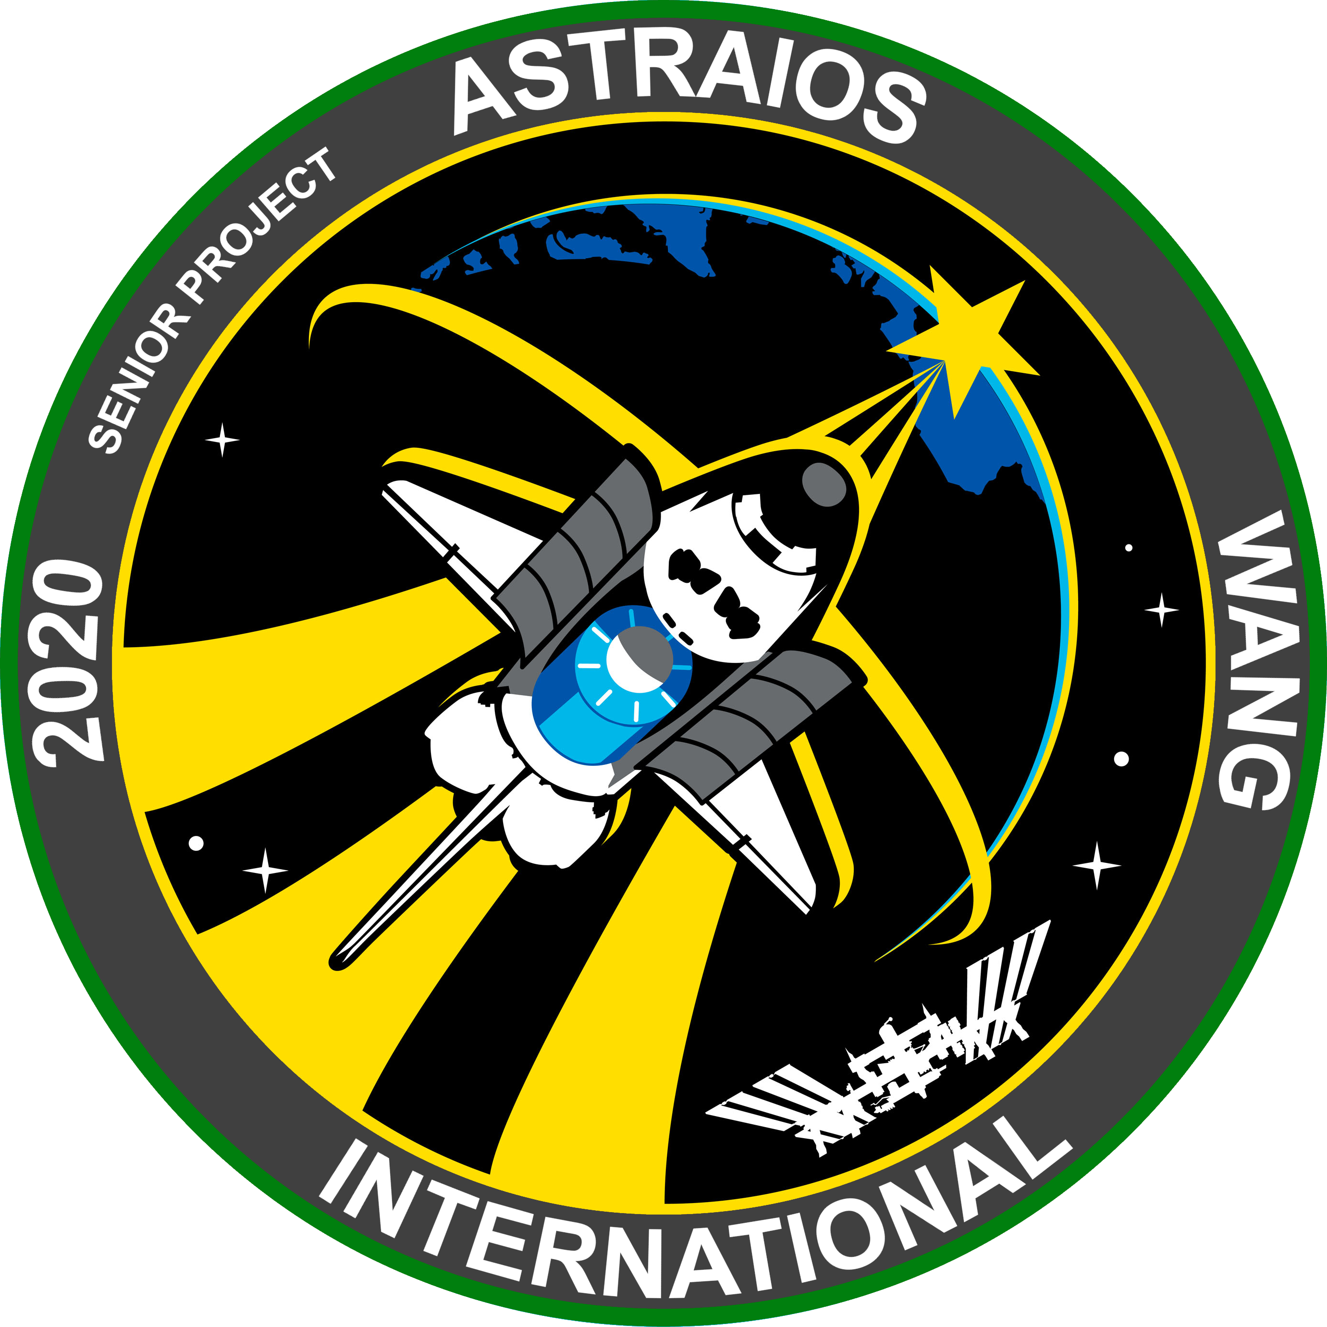

1
2
4
3

Slide 15
Community INVOlvement
The project allowed me to create curriculum material for the Flight and Space class at Tyee Middle School.
I was able to obtain survey data from 15 middle school students on their thoughts on the video lesson.
My video helped students understand the Tyee Flight Controller better and created another resource my mentor can use in his class.

Slide 16
Problem solving
School closures forced me to stop working with the students at Tyee Middle School, it also stopped me from accessing the workspace where I could access tools to make my satellite.
The resulted in me having to change my project up drastically, shifting to a project where I would engage with my community through a YouTube video.
This change allowed me to continue to work on my project to still involve my community, but no longer depend on the physical workspace.
The closure was a unforeseen event and I wouldn’t have planned for it, but I did my best to contact my mentor and teacher for assistance.

Slide 17
Analysis
My learning stretch goal was focused on design and engineering. Through this half I learned to design a logo as well as a get more familiar with CAD.
Despite the closures, I was able to switch my project to where I could still make an impact in the community.
Some of the things which I learned came from my own experience from robotics, but another portion of it largely came from research that I did on my own and from my mentor.
Overall, I was able to learn a variety of skills which proved important for me for my own learning goals.

Slide 18
PROFEESIONALISM GOAL
Seniors plan and implement a project that demonstrates how performance, effort and decisions directly affect success. Seniors communicate effectively, forge productive relationships with stakeholders, and manage the details of the project professionally. This includes demonstrating tenacity, adaptability, and creativity in anticipating and mitigating problems.
Total Hours Spent on Project: 89.6

Slide 19
Context
How did you demonstrate professionalism?
Most of the communication with my mentor was over email.
What areas did you have to improve?
I think I needed to improve on following up with my contacts.
What challenges did you run into?
Because of the school closure, I had to find an alternative way to meet with my mentor via TEAMS
What did you learn?
I learned that professionalism is VERY important
I demonstrated professionalism by being punctual for meetings, as well as responding to emails promptly.
I also think I need to improve on conveying my ideas to others in a eloquent way.
Projects happen through human interaction, the ability to effectively communicate ideas is valuable.

Slide 20
Successes/Areas of Growth I
Respond to emails as soon as possible, make a habit of checking your email periodically
Confirm a schedule with whoever you’re contacting so you’re on the same page
Always proofread your email and make sure you re-read what you will send.
Notes:
My goal was to design a CAD mockup of the satellite that I was going to build. Going into the process I had some experience using Autodesk inventor in robotics. The main component was choosing a design which would be optimal in the constraints for the satellite. (500grams, 6”x6”x6”). Prior to designing the satellite, I did extensive research to determine what shape I wanted. Throughout the process of making my satellite I encountered some roadblocks such as trying to figure out what constraint to use or ensuring that my measurements were correct in order to achieve the correct geometry. This experience helped me get much more familiar with inventor and discover new tools and features within the application.

Slide 21
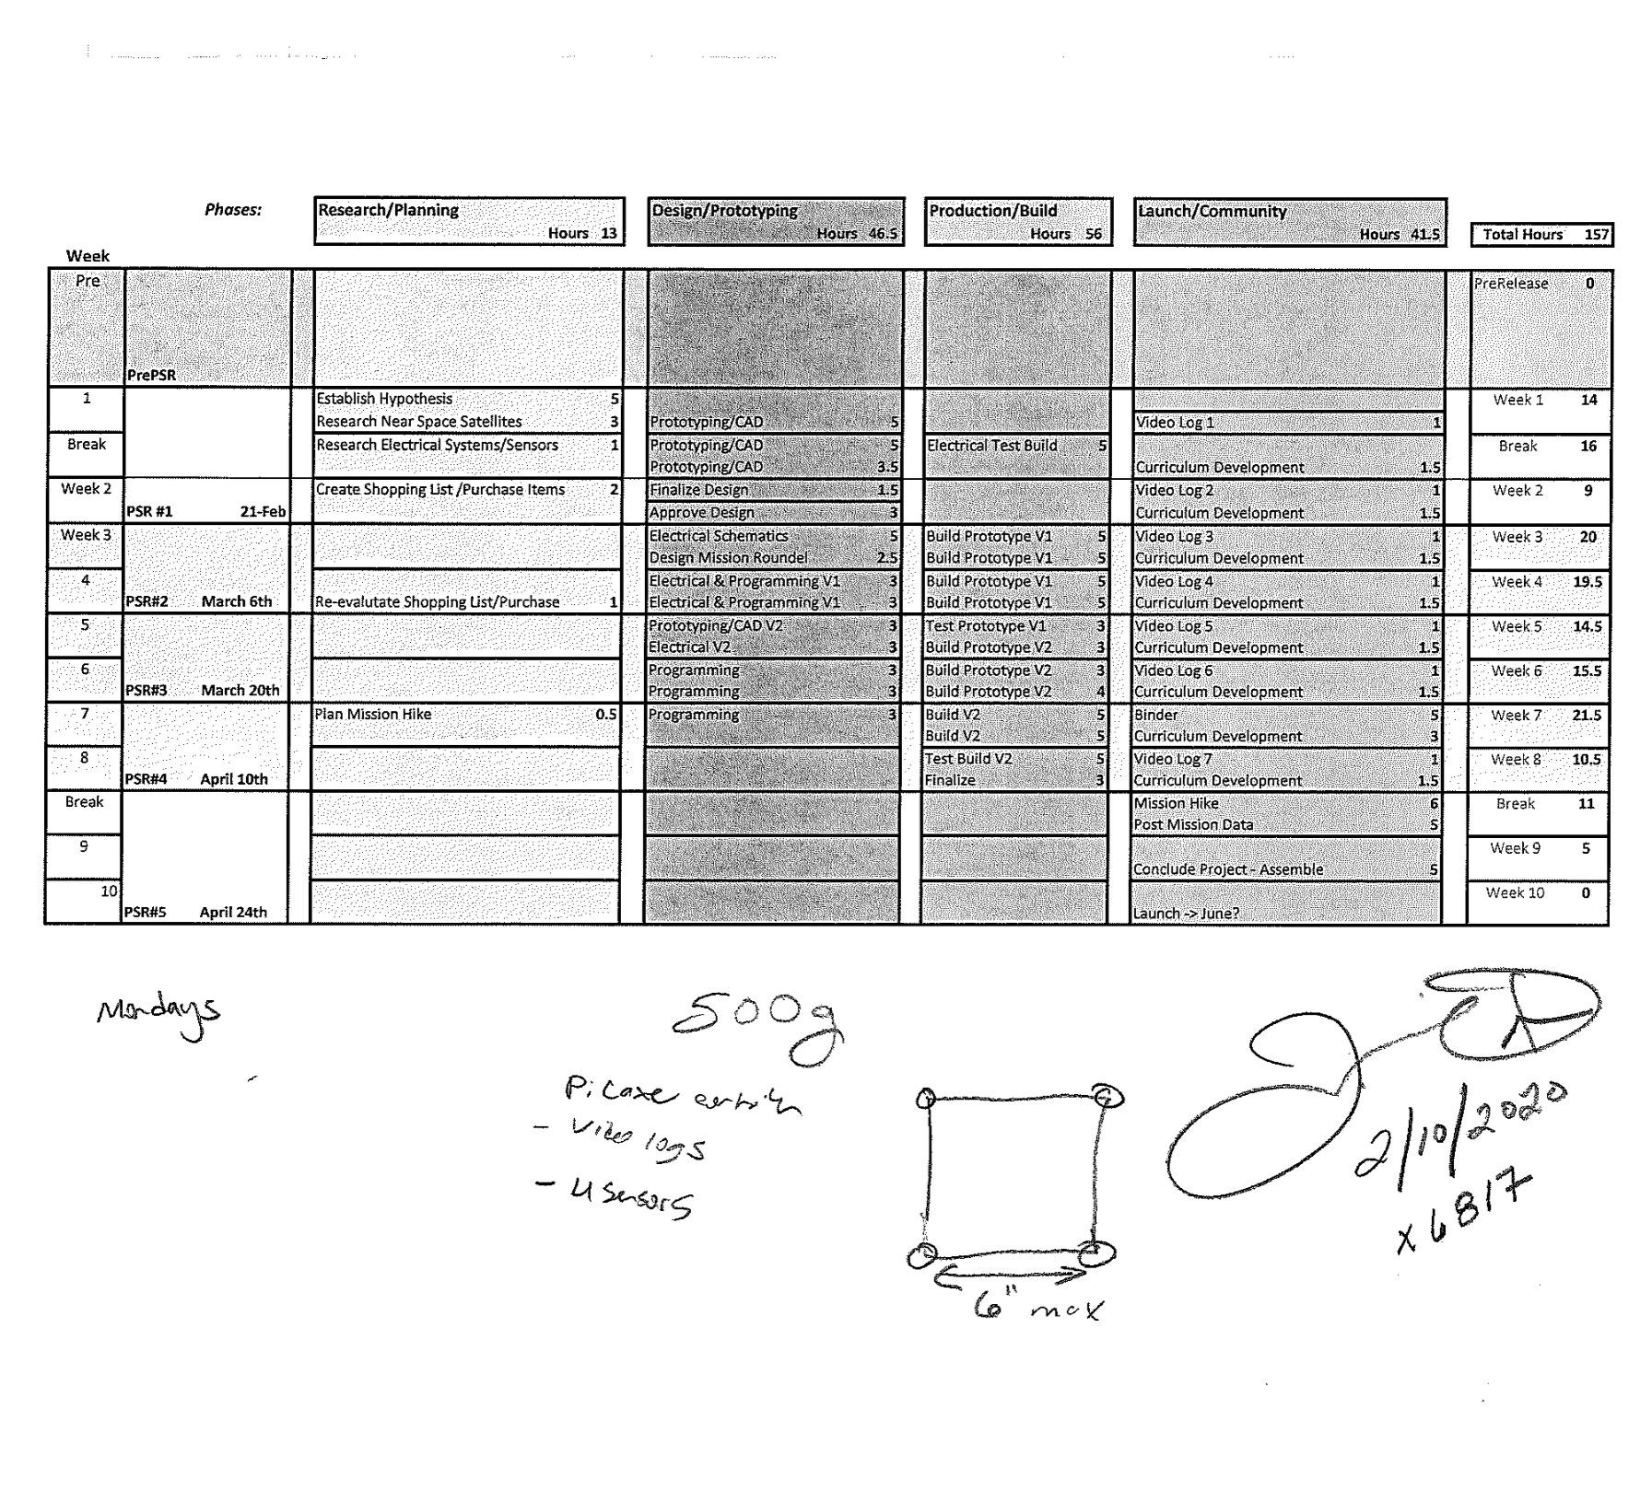
Deliverable 1
Scheduling With Mentor

Slide 22
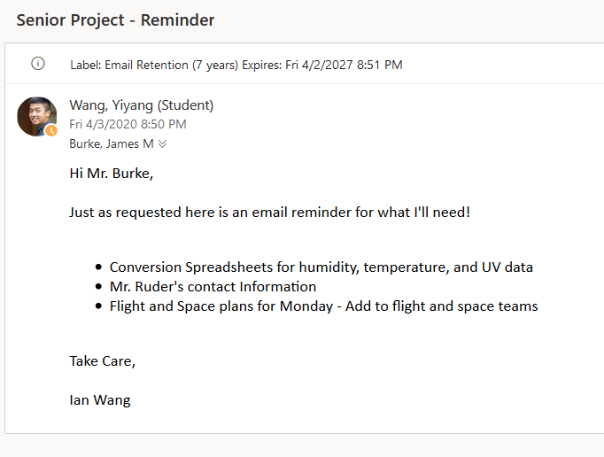
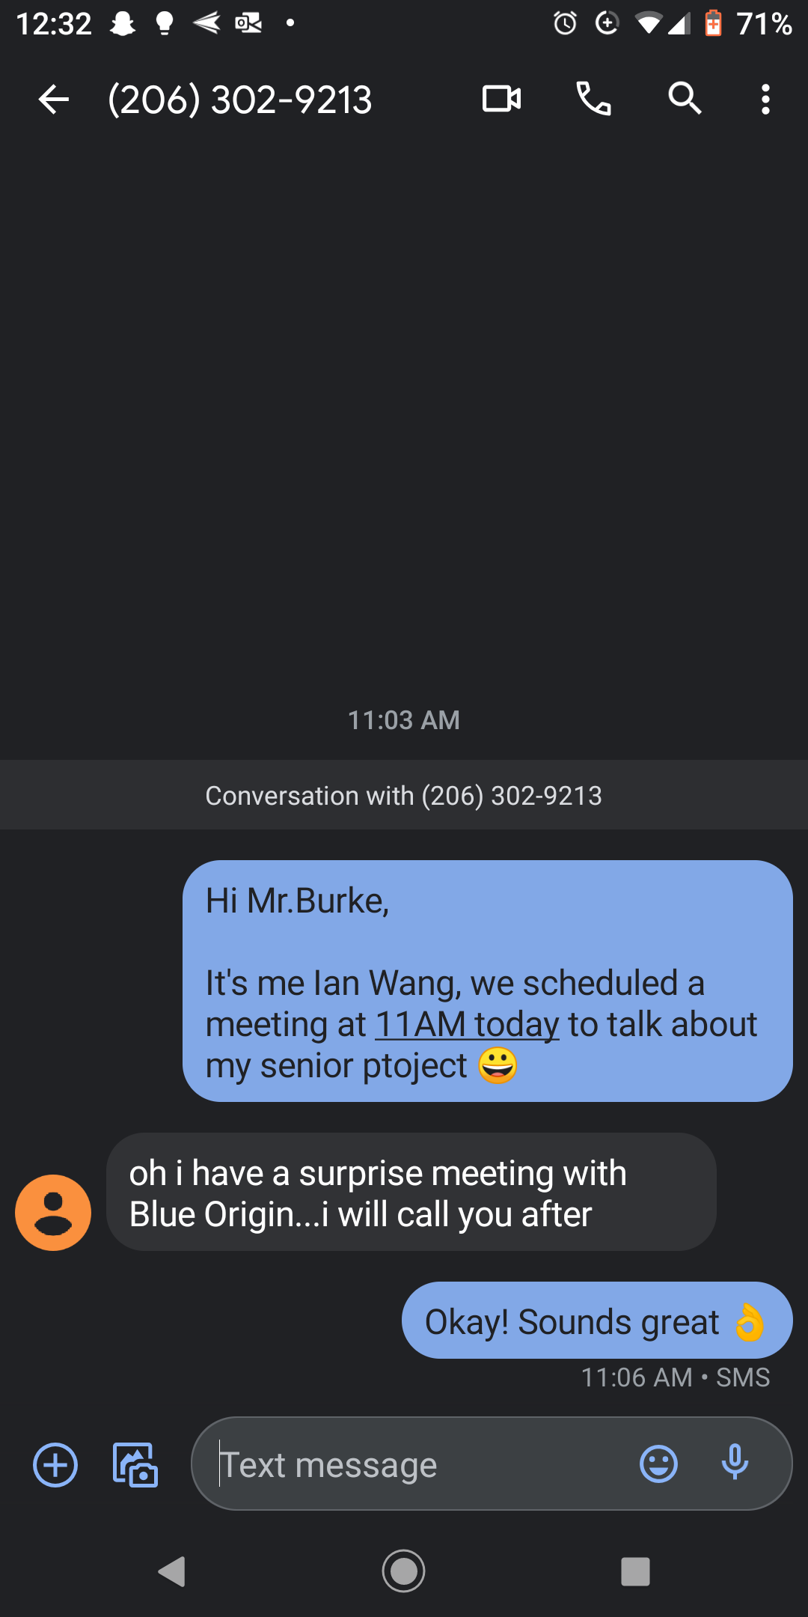
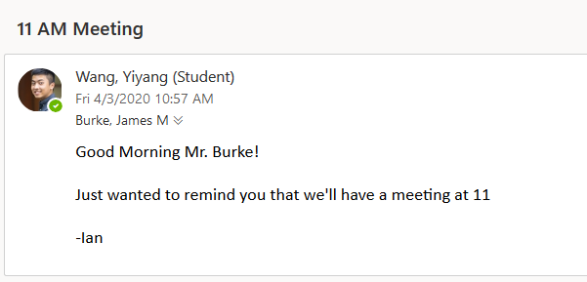
Email Reminders
Text to my mentor

Slide 23
Successes/Areas of Growth II
Communicate your ideas clearly and eloquently
Be sure to always thank the person on the receiving end of your email
Don’t be afraid to reach out to people you don’t know
Notes:
My goal was to design a CAD mockup of the satellite that I was going to build. Going into the process I had some experience using Autodesk inventor in robotics. The main component was choosing a design which would be optimal in the constraints for the satellite. (500grams, 6”x6”x6”). Prior to designing the satellite, I did extensive research to determine what shape I wanted. Throughout the process of making my satellite I encountered some roadblocks such as trying to figure out what constraint to use or ensuring that my measurements were correct in order to achieve the correct geometry. This experience helped me get much more familiar with inventor and discover new tools and features within the application.

Slide 24
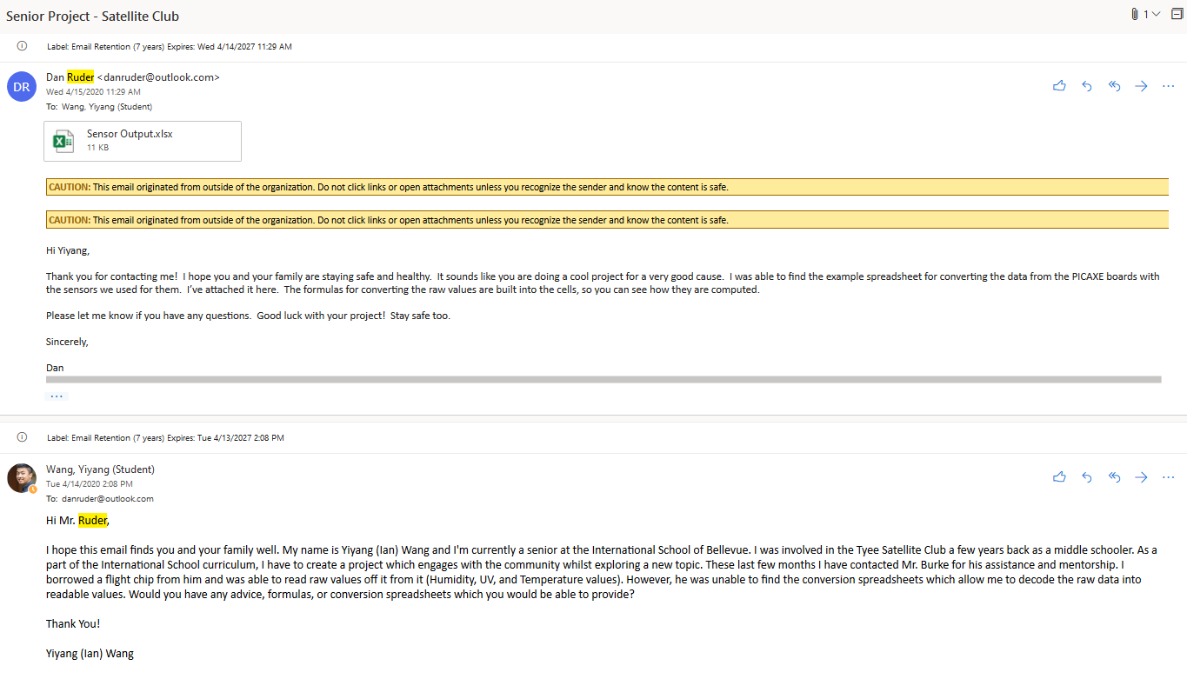
Reached out to Experts

Slide 25
Analysis
I learned to not expect the person you’re emailing to respond ASAP, as they might be dealing with a lot of things, be tactful. But build a habit of responding emails as soon as possible.
Be concise and let the receiver know what you are saying. Communicate effectively with less words
Don’t be afraid to reach out to people you don’t know.
Try to set up schedule set time if you’re planning a meeting, and make sure both parties are on board.

Slide 26
Project Achievement Goal
I will create a video lesson explaining the different components of the Tyee Flight Controller. I will also be CADing, programming my own satellite, as well as creating a mission patch. My mentor is James Burke who works at Tyee Middle School as a STEM & CTE teacher. By creating a video lesson explaining the Tyee Flight Controller, I hope to help students understand the components of their satellite better. I also hope to provide an additional resource for my mentor to use in his Flight and Space curriculum at Tyee. My portfolio will showcase my video lesson, mission patch design, as well as my satellite model.

Slide 27
Context
What made you choose this topic?
I chose this topic because I wanted to put the skills which I learned in robotic and my AP CS class to use.
Explain your motivation for choosing this project.
My motivation for choosing this project is to learn more about near space satellites, as well as to educate students.
Did you have any previous experience with the topic?
I do have previous experience. In middle school I was involved in the Tyee Satellite Club Program.
What were you hoping to accomplish?
I was hoping to create my own CAD model, mission logo, as well as create a video lesson for students to use to better understand the flight controller.

Slide 28
Successes/Areas of Growth I
I did multiple trials when capturing data with the Flight Controller; important in making sure I had valid data.
The internet has a huge amount of resources but be sure to take everything with a grain of salt.
I should’ve double checked my information before being so sure about a part on the board.
Troubleshooting is important and part of the process of learning. Don’t be discouraged.
Notes:
My goal was to design a CAD mockup of the satellite that I was going to build. Going into the process I had some experience using Autodesk inventor in robotics. The main component was choosing a design which would be optimal in the constraints for the satellite. (500grams, 6”x6”x6”). Prior to designing the satellite, I did extensive research to determine what shape I wanted. Throughout the process of making my satellite I encountered some roadblocks such as trying to figure out what constraint to use or ensuring that my measurements were correct in order to achieve the correct geometry. This experience helped me get much more familiar with inventor and discover new tools and features within the application.

Slide 29
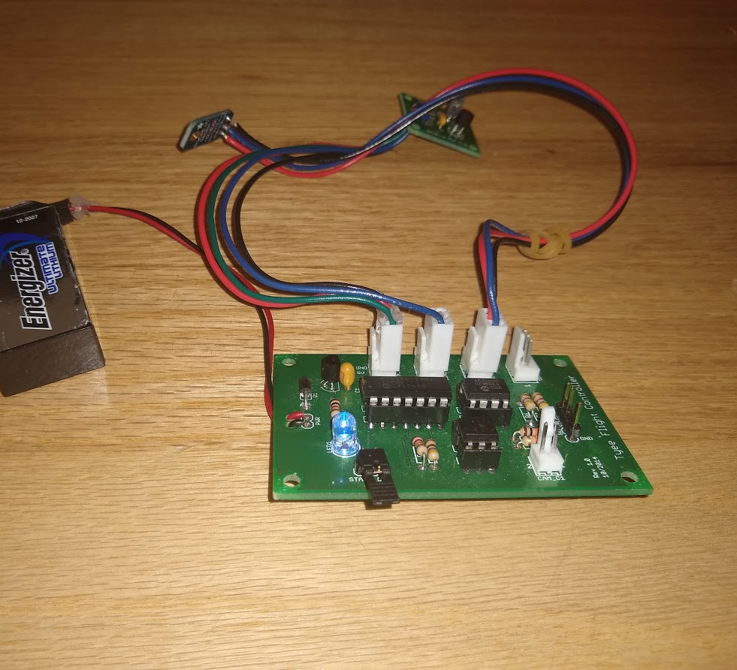
Deliverable 1
Tyee Flight Controller

Slide 30
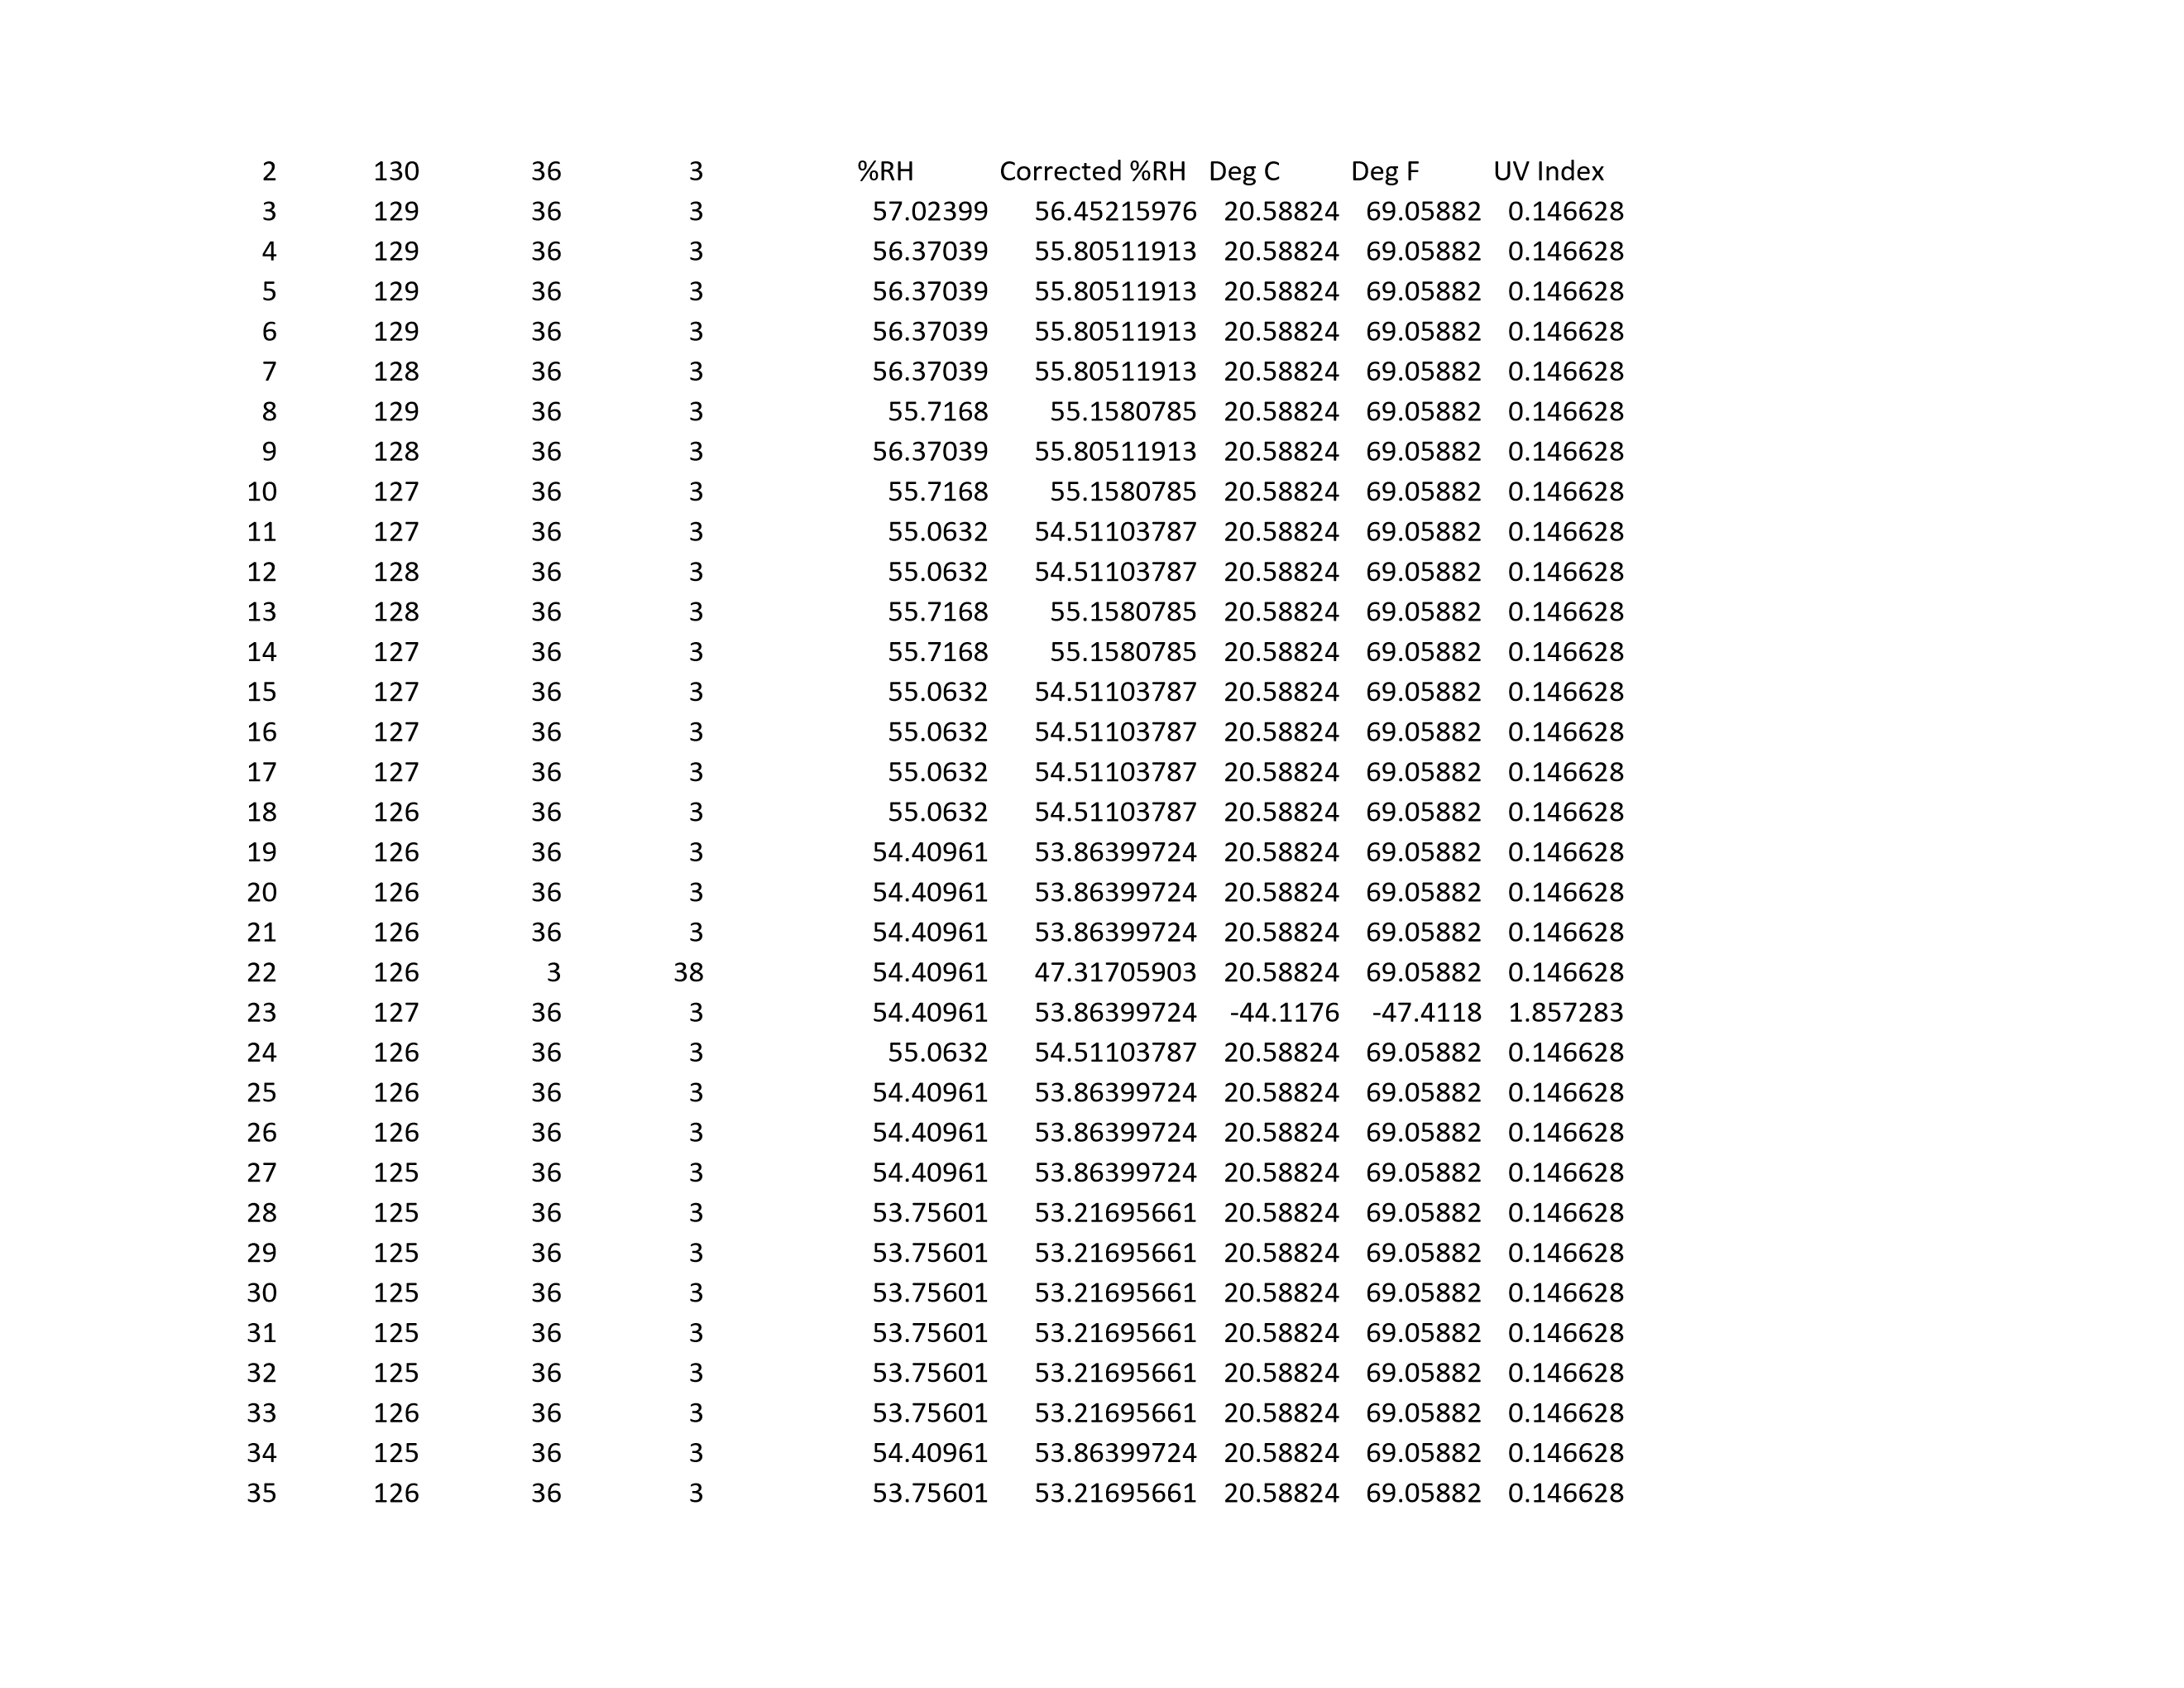
Relative Humidity
Temperature
UV Index
Data Collected from
Flight Controller

Slide 31
Successes/Areas of Growth II
When making a video make sure its accessible and engaging.
People learn differently include a wide variety of visuals to help your audience understand your message.
I think the video I made was good in terms of content but may have been a bit dull in terms of delivering information.
Notes:
My goal was to design a CAD mockup of the satellite that I was going to build. Going into the process I had some experience using Autodesk inventor in robotics. The main component was choosing a design which would be optimal in the constraints for the satellite. (500grams, 6”x6”x6”). Prior to designing the satellite, I did extensive research to determine what shape I wanted. Throughout the process of making my satellite I encountered some roadblocks such as trying to figure out what constraint to use or ensuring that my measurements were correct in order to achieve the correct geometry. This experience helped me get much more familiar with inventor and discover new tools and features within the application.

Slide 32
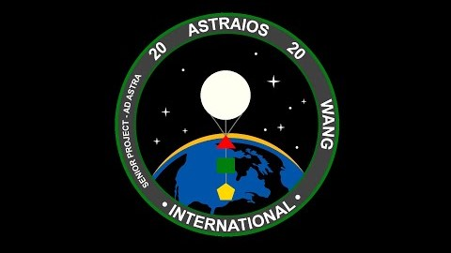

Slide 33
Analysis
I learned that there are many different considerations in order to make a video appealing to your target audience.
When you are dealing with facts, make sure you cross-reference information before you confirm that it’s true. Consult more than one source!
I had a long time trying to figure out what was wrong with my code because the flight controller wouldn’t take values down. Through that process I learned a lot about the flight controller.
As we’ve learned in science class, do MANY trials to ensure the validity of your data.

Slide 34
Summary of learning
Through this project, I had learned a lot of soft-skills as well as technical skills which will greatly help me in the future. My main goals in this project from the beginning was to help the community as well as learn something new. All of which I had accomplished. Overall the processes of designing the satellite and mission patch, as well as filming the video greatly helped me discover a new interest which is user interface and experience development. I had a fun time doing this project and if I could redo it, I’d build the satellite which I designed.

Slide 35
Thank You
Any Questions?

